Slide 1

Jungheinrich Digital Saloon Hamburg | January 2020 | @nilshartmann
NILS HARTMANN
https://nilshartmann.net
Introduction to
GraphQL
Slides: https://nils.buzz/jds-graphql

Slide 2

https://nilshartmann.net
NILS HARTMANN
nils@nilshartmann.net
Freelance Developer, Coach and Trainer from Hamburg
Java
JavaScript, TypeScript
React
GraphQL
https://reactbuch.de

Slide 3
https://nilshartmann.net
NILS HARTMANN
nils@nilshartmann.net
Freelance Developer, Coach and Trainer from Hamburg
Java
JavaScript, TypeScript
React
GraphQL
Trainings, Workshops and Consulting
https://reactbuch.de

Slide 4
https://nilshartmann.net
NILS HARTMANN
nils@nilshartmann.net
Freelance Developer, Coach and Trainer from Hamburg
Java
JavaScript, TypeScript
React
GraphQL
Trainings, Workshops and Consulting
Beer drinking
https://reactbuch.de
(german only)

Slide 5
"GraphQL is a query language for APIs and a runtime for fulfilling those queries with your existing data"
- https://graphql.org
GraphQL

Slide 6
GraphQL
Specification: https://graphql.org/
2015 published by Facebook
Development since 2018 inside GraphQL Foundation
Spec contains:
Query language and execution
Schema definition language
But not: Implementation
Reference implementation: graphql-js

Slide 7
GraphQL
GraphQL != SQL
it‘s not SQL
it‘s not as powerful and flexible as SQL
no ordering, no paginating, no joins out-of-the-box
no database!
no framework!

Slide 8
GraphQL
GraphQL != Implementation
GraphQL itself only is a specified language
there are libs for a couple of languages that helps you integrating and implementing GraphQL into your application

Slide 9
GraphQL
GraphQL != Mainstream
Implenentation and usage is still „bleeding edge“
Not many best practices and experiences
...but it is already in use, also by big players!

Slide 10

GitHub
https://twitter.com/github/status/866590967314472960

Slide 11

Twitter
https://twitter.com/tgvashworth/status/862049341472522240

Slide 12

New York Times
https://open.nytimes.com/react-relay-and-graphql-under-the-hood-of-the-times-website-redesign-22fb62ea9764

Slide 13
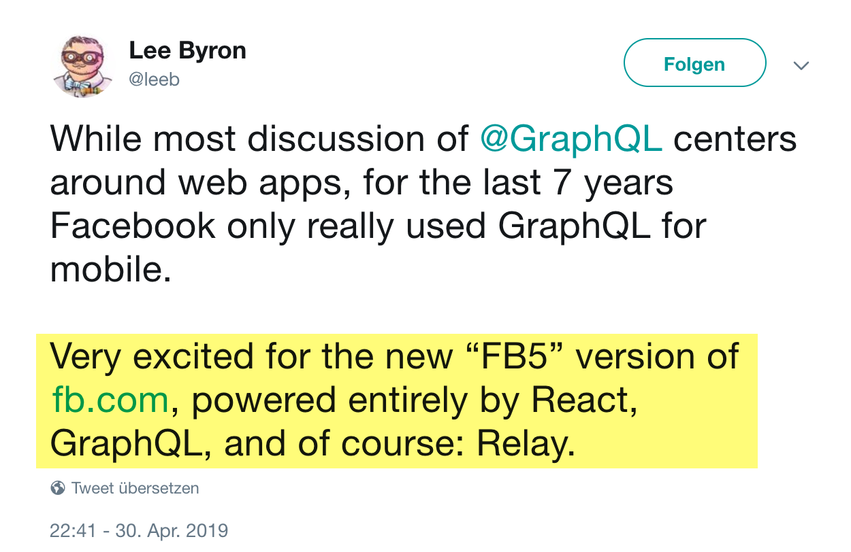
Facebook 5
https://twitter.com/leeb/status/1123326647552266241

Slide 14

Source-Code: https://nils.buzz/graphql-java-example
GraphQL in action

Slide 15

http://localhost:9000/
Demo: GraphiQL

Slide 16
Compare with REST 😱

Slide 17
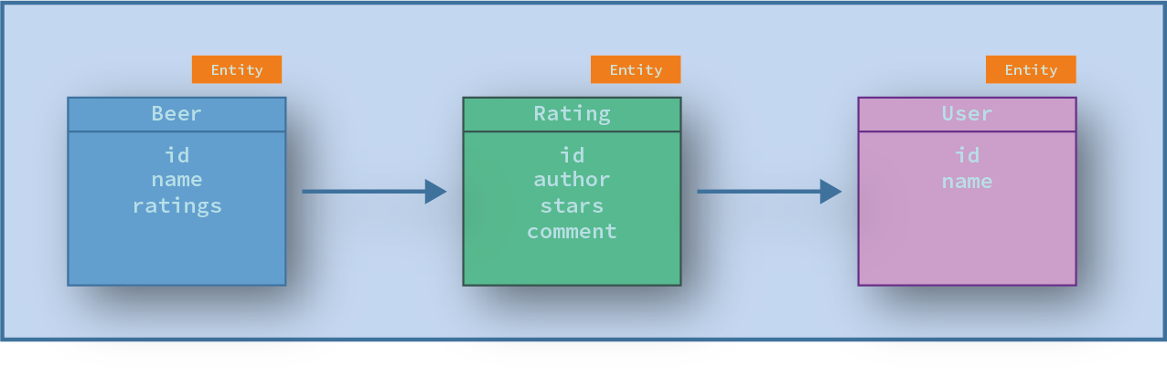
BeerAdvisor domain
"Domain-Model"

Slide 18
Requests with REST
A potential REST API
Exemplary and simplified
GET /beer/1
{
"id": "1",
"name": "Barfüßer"
}

Slide 19
Requests with REST
A potential REST API
Exemplary and simplified
GET /beer/1
GET /beer/1/rating/R1
{
"id": "1",
"name": "Barfüßer"
}
{
"id": "R1",
"author": "U1",
"stars": 3,
"comment": "good!"
}

Slide 20
Requests with REST
REST API
For each entity (Resource) one Request
We always get the whole Resource (no standard way to get only partial resources)
There is no „overall view“ on our domain
GET /beer/1
GET /beer/1/rating/R1
GET /user/U1
{
"id": "1",
"name": "Barfüßer"
}
{
"id": "R1",
"author": "U1",
"stars": 3,
"comment": "good!"
}
{
"id": "U1",
"name": "Klaus",
}

Slide 21
Requests with graphQL
GraphQL
query { beer
{ name ratings(rid: "R1")
{ stars author { name }
}
}
{
"name": "Barfüßer",
"ratings": {
"stars": 3,
"comment: "good",
"author": { "name": "Klaus" }
}
}

Slide 22

GraphQL Use-Cases
Use-Case specific requests – 1
{ beer {
id
name
averageStars
}
}

Slide 23

GraphQL Use-Cases
Use-Case specific requests – 2
{ beer(beerId: "B1" {
name
price
ratings {
stars
comment
author {
name
}
}
shops { name }
}
}

Slide 24

GraphQL Use-Cases
Use-Case specific requests – 3
{ shop(shopId: "S3") {
name
address { street city }
beers { id name }
}
}

Slide 25
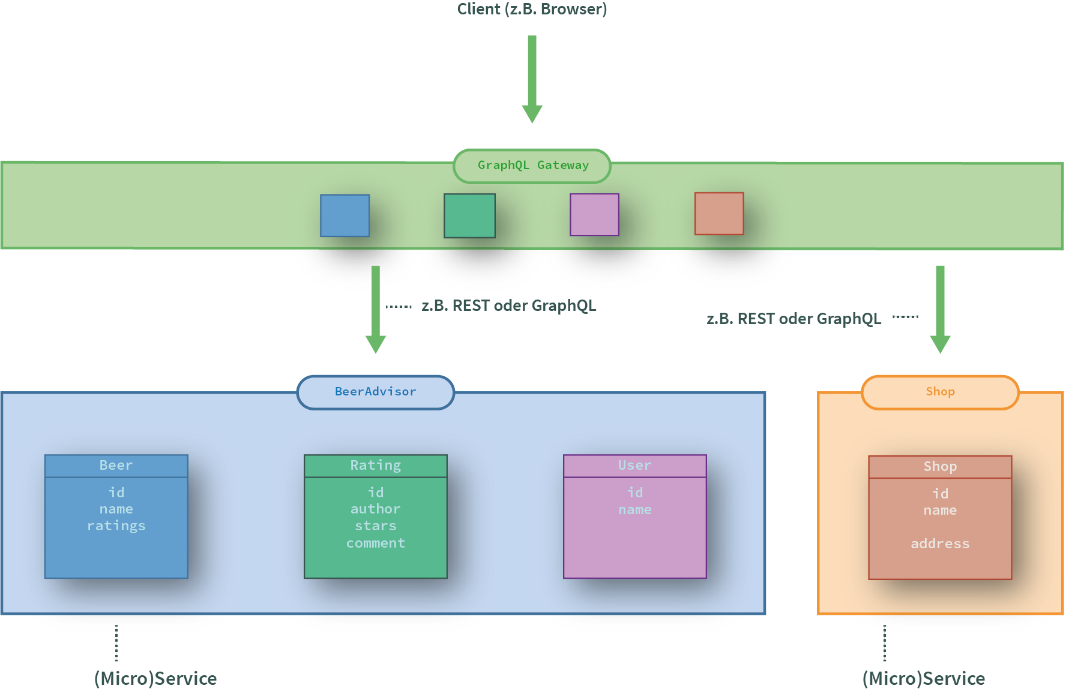
Einsatzszenarien
Single gateway for frontends/clients to couple of services
Probably not: service-to-service communication

Slide 26

Datasources
GraphQL makes no statement, where data comes from
👉 Providing the data is up to us

Slide 27
Teil 1: Abfragen und Schema
"GraphQL is a query language for APIs and a runtime for fulfilling those queries with your existing data"
- https://graphql.org
GraphQL

Slide 28
query Language
Structured language to retrieve data from the API
Fields of (nested) objects are queried

Slide 29
query Language
Structured language to retrieve data from the API
Fields of (nested) objects are queried
Fields can have arguments

Slide 30
query Language
Response
Identical structure as for the query

Slide 31
query Language: Operations
Operation: describes what is to be done
query, mutation, subscription

Slide 32
query Language: Mutations
Mutations
Mutations are used to modify data
Comparable to POST, PUT, PATCH, DELETE in REST

Slide 33
query Language: Mutations
Subscription
Receiving events from the server

Slide 34
Execution of Queries
Queries are executed normally using HTTP requests
$ curl -X POST -H "Content-Type: application/json" \
-d '{"query":"{ beers { name } }"}' \
http://localhost:9000/graphql
{"data":
{"beers": [
{"name": "Barfüßer"},
{"name": "Frydenlund"},
{"name": "Grieskirchner"},
{"name": "Tuborg"},
{"name": "Baltic Tripple"},
{"name": "Viktoria Bier"}
]}
}

Slide 35
GraphQL Schema
Schema
A GraphQL API must have a schema describing it
The schema determines the available Types and Fields
Only requests and responses matching the query are executed and returned
Schema Definition Language (SDL)

Slide 36
GraphQL Schema
Schema Definition using SDL
Object Type
type Rating { id: ID!
comment: String! stars: Int
}
Fields

Slide 37
GraphQL Schema
Schema Definition using SDL
type Rating { id: ID!
comment: String! stars: Int
}
Return Type (non-nullable)
Return Type (nullable)

Slide 38
GraphQL Schema
Schema Definition using SDL
type Rating { id: ID!
comment: String! stars: Int
author: User! }
type User {
id: ID!
name: String!
}
Reference to other type

Slide 39
GraphQL Schema
Schema Definition using SDL
type Rating { id: ID!
comment: String! stars: Int
author: User! }
type User {
id: ID!
name: String!
}
type Beer {
name: String!
ratings: [Rating!]!
}
List / Array

Slide 40
GraphQL Schema
Root-Types: Entry points into the API (Query, Mutation, Subscription)
Root-Type
("Query)
type Query { beers: [Beer!]!
beer(beerId: ID!): Beer }
Root-Fields

Slide 41
GraphQL Schema
Root-Types: Entry points into the API (Query, Mutation, Subscription)
Root-Type
("Query)
type Query { beers: [Beer!]!
beer(beerId: ID!): Beer }
type Mutation { addRating(newRating: NewRating): Rating! }
Root-Fields
Root-Type
("Mutation")

Slide 42
GraphQL Schema
Root-Types: Entry points into the API (Query, Mutation, Subscription)
Root-Type
("Query)
type Query { beers: [Beer!]!
beer(beerId: ID!): Beer }
type Mutation { addRating(newRating: NewRating): Rating! }
type Subscription {
onNewRating: Rating!
}
Root-Fields
Root-Type
("Mutation")
Root-Type
("Subscription")

Slide 43
GraphQL Schema
Evolution of the Schema: Only one version of the schema
type Query { beers: [Beer!]!
}

Slide 44
GraphQL Schema
Evolution of the Schema: Only one version of the schema
Fields are always requested explicitly by name (no „select all“)
New fields can be added without harming existing clients
type Query { beers: [Beer!]!
getBeerById(beerId: ID!): Beer
}
New field

Slide 45
GraphQL Schema
Evolution of the Schema: Only one version of the schema
Fields are always requested explicitly by name (no „select all“)
New fields can be added without harming existing clients
Old fields can be 'deprecated‘
Usage of fields can be tracked individually
type Query { beers: [Beer!]!
getBeerById(beerId: ID!): Beer
beer(beerId: ID!): Beer @deprecated }
New Feld

Slide 46
Part 2: Runtime-environment (AKA: your application)
"GraphQL is a query language for APIs and a runtime for fulfilling those queries with your existing data"
- https://graphql.org
GraphQL
in your App
(Example: Java, but concepts similiar with other languages)

Slide 47
Example: GraphQL for Java
Step 1: Define your Schema
type User { id: ID! login: String! name: String! } type Rating { id: ID! beer: Beer! author: User! comment: String! stars: Int! } type Beer { id: ID! name: String! price: String! ratings: [Rating!]!
ratingsWithStars(stars: Int!): [Rating!]! }
type Query { beer(beerId: ID!): Beer beers: [Beer!]! }
input AddRatingInput { beerId: ID! userId: ID! comment: String! stars: Int! }
type Mutation { addRating(ratingInput: AddRatingInput):
Rating! }

Slide 48
Example: GraphQL for Java
Step 2: DataFetcher
(In other libraries often called Resolver )
A DataFetcher (or Resolver) returns a value for a request field
Mandatory only for Root-Types (Query, Mutation)
interface DataFetcher<T> { T get(DataFetchingEnvironment environment); }

Slide 49
DataFetcher
Step 2: DataFetcher
Example: DataFetcher for beers field
public class BeerAdvisorDataFetchers {
public DataFetcher<List<Beer>> beersFetcher() {
return environment -> beerRepository.findAll();
}
}
type Query { beers: [Beer!]!
}

Slide 50
DataFetcher
Step 2: DataFetcher
Example: accessing field arguments
public class BeerAdvisorDataFetchers {
public DataFetcher<List<Beer>> beersFetcher() {
return environment -> beerRepository.findAll();
}
public DataFetcher<Beer> beerFetcher() {
return environment -> {
String beerId = environment.getArgument("beerId");
return beerRepository.getBeer(beerId);
};
}
}
}
type Query { beers: [Beer!]!
beer(beerId: ID!): Beer
}

Slide 51
Optimization
There are several ways to optimize for perfomance
Depending on the library you use
One common technique: DataLoader to avoid n+1-problems
Others address
caching (yes, you can cache!)
reducing calls to databases

Slide 52
Outlook
GraphQL Code Generator
Generator for various languages and libraries: https://graphql-code-generator.com/
Generator for Queries and Response Types (Java): https://github.com/adobe/graphql-java-generator

Slide 53
outlook
GraphQL for databases
Instant GraphQL Schema for PostgresDB (Node.JS): https://www.graphile.org/postgraphile/
Instant GraphQL Schema for PostgresDB: https://hasura.io/
GraphQL as ORM (JavaScript, Go): https://prisma.io/

Slide 54
GraphQL
Summary
Interesting, but still young technology Breaks with habits from REST Requires re-thinking concepts and REST and GraphQL can be used together in one app
Does neither replace your Backend nor your Database
Libs and Frameworks for many languages (Java, JS, C#, ...) Prototypes for exploration and evaluation is setup usually quickly
My recommendation: (at least) give it a try and follow further development

Slide 55
HTTPS://NILSHARTMANN.NET
🍻
https://reactbuch.de
Thank you very much!
Example code: https://nils.buzz/graphql-java-example
Slides: https://nils.buzz/jds-graphql
Contact: nils@nilshartmann.net
Twitter: @nilshartmann

